Slide 1
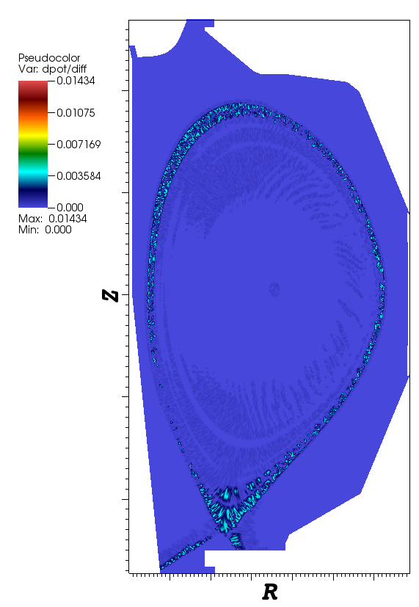
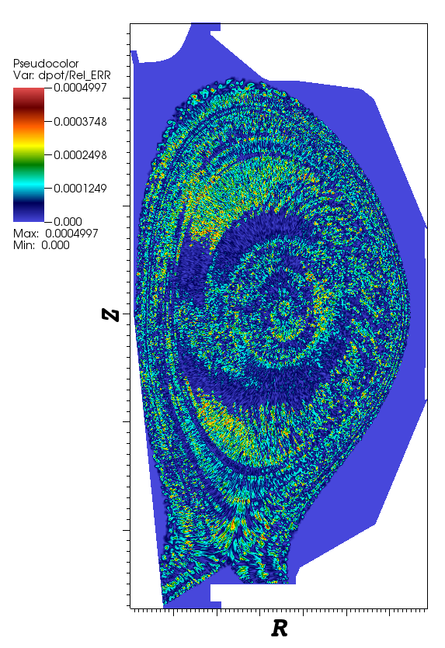
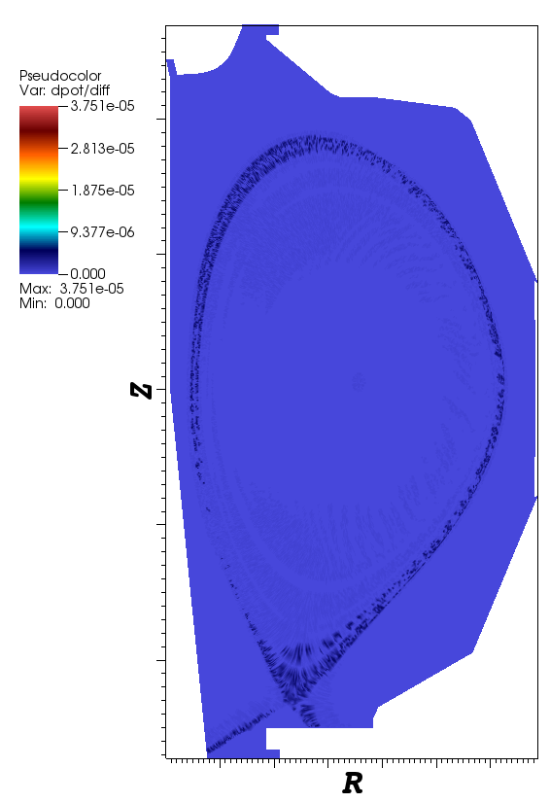
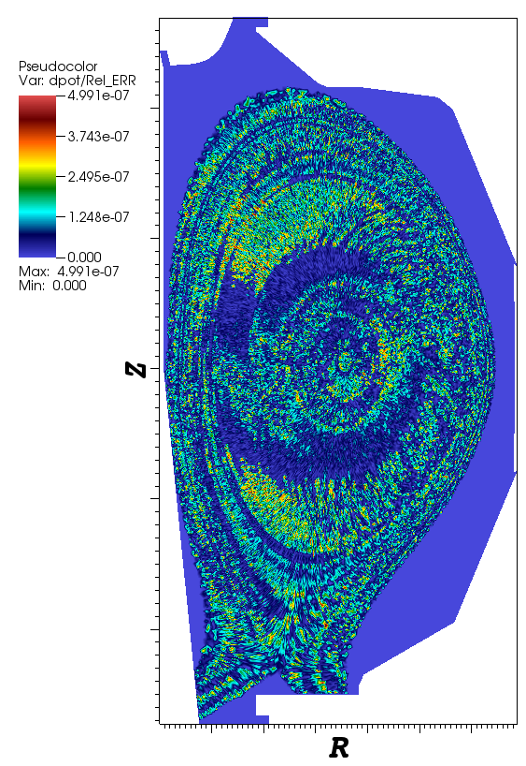
Stupid obvious stuff
Precision=3
Precision=6
Diff
Rel error
Diff
Rel error

Slide 2
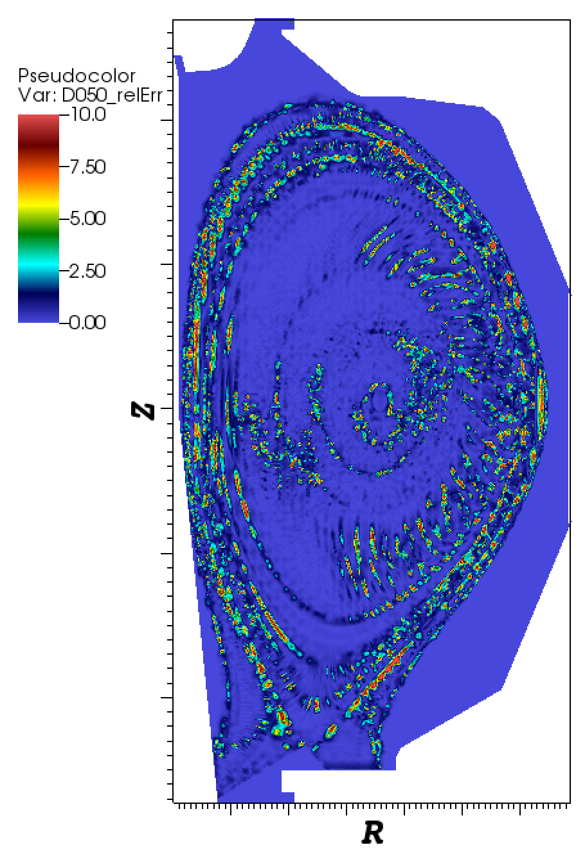
Errors with decimation
Note: this is uniform DUMB decimation. I was experimenting with “smart” decimation, but no results yet.
95% decimation

Slide 3
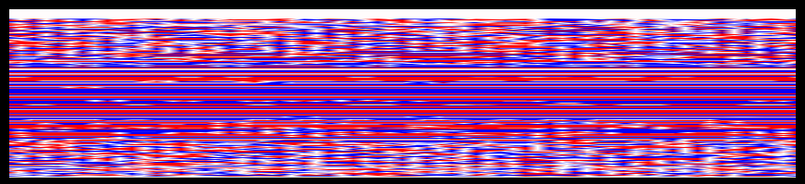
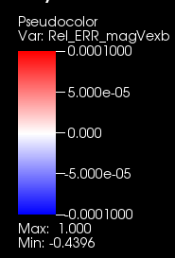
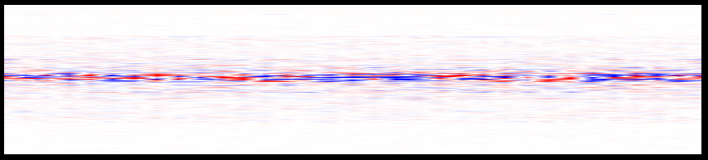
Z=0
Z=0, Relative error | Vexb | precision=3
Z=0, Relative error | Vexb | precision=6

Slide 4
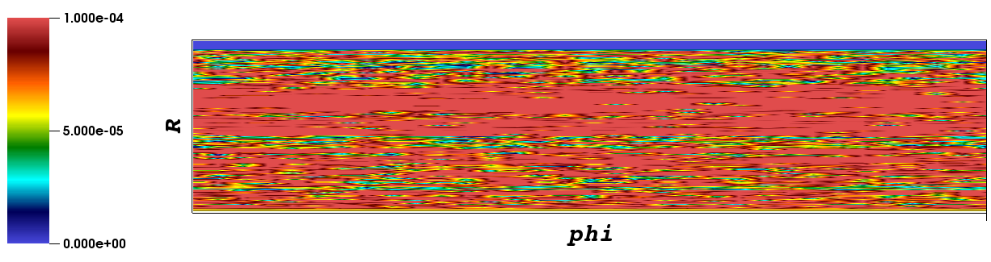
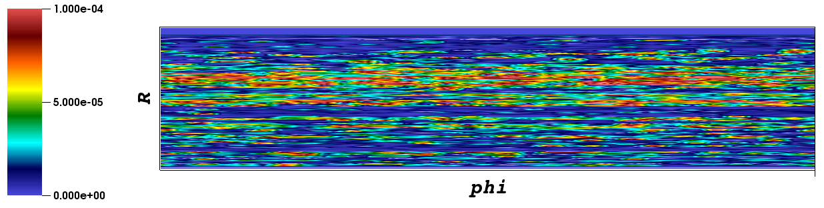
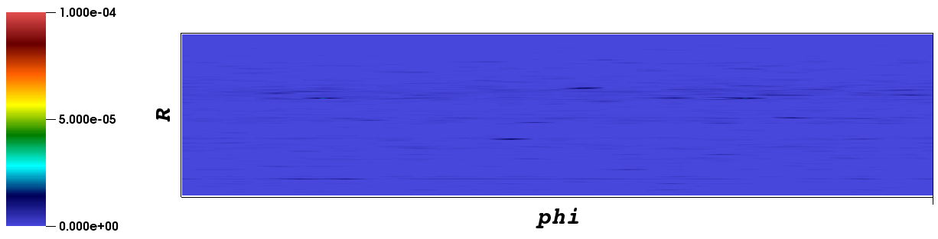
Variable= | (gradient(dpot) x B)/|B| |
Relative errors
Precision = 3
Precision = 4
Precision = 6

Slide 5
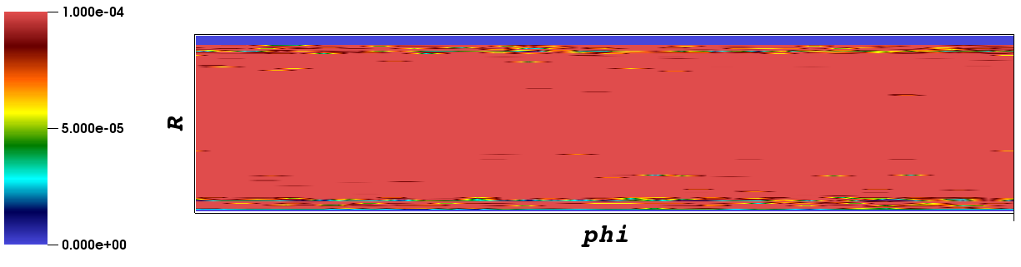
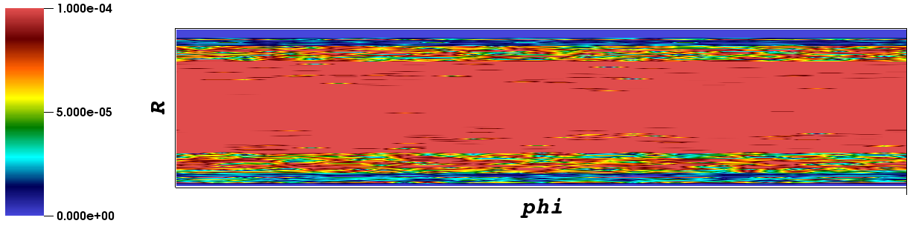
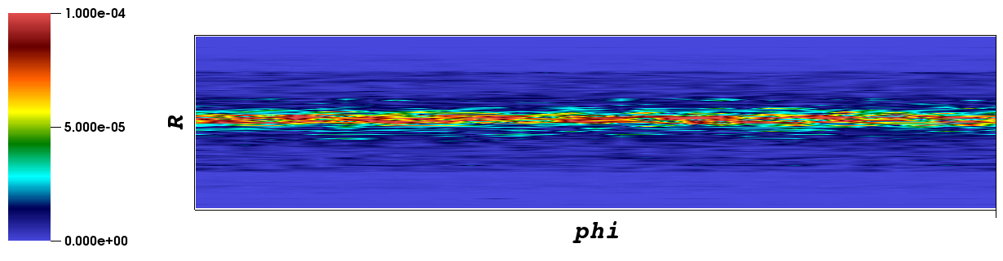
Variable= | (gradient(e) x B)/|B| |
Relative errors
Precision = 3
Precision = 4
Precision = 6

Slide 6
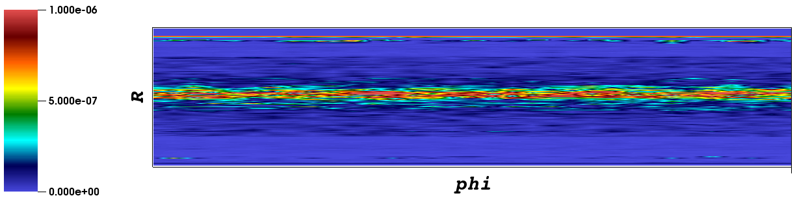
Variable= | (gradient(e) x B)/|B| |
Relative errors
Precision = 8

Slide 7
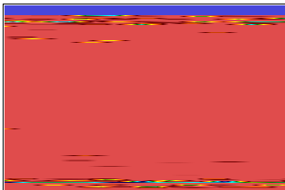
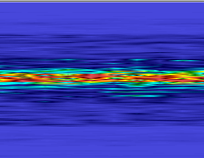

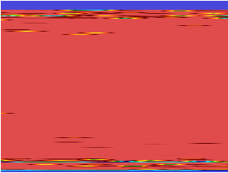
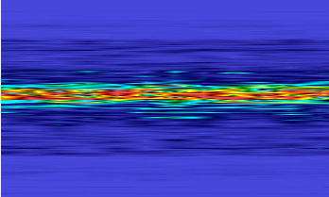

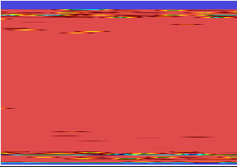
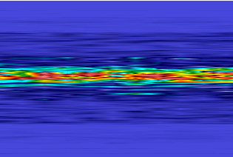
Variable= | (gradient(e) x B)/|B| |
Mixed precision for e, B
Error defined by e
 | E=3 | E=6 | E=full
B=3
B=6
B=full

Slide 8
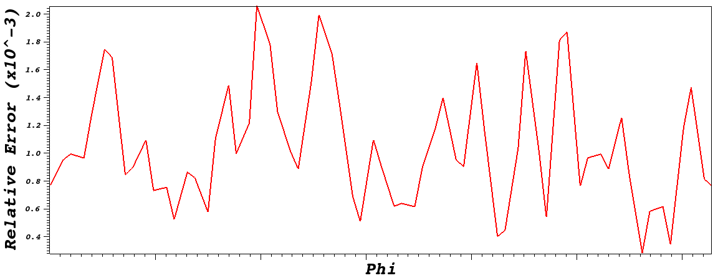
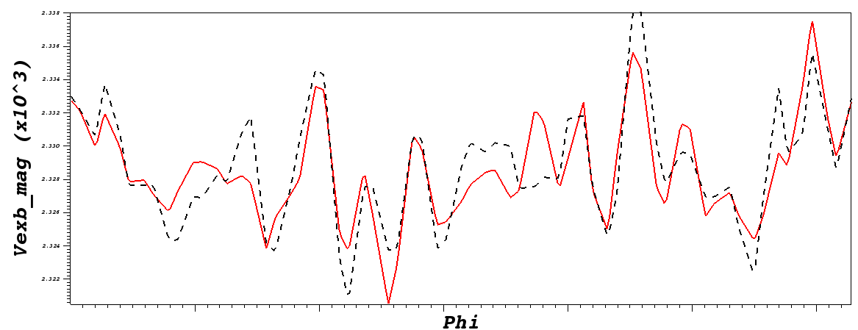
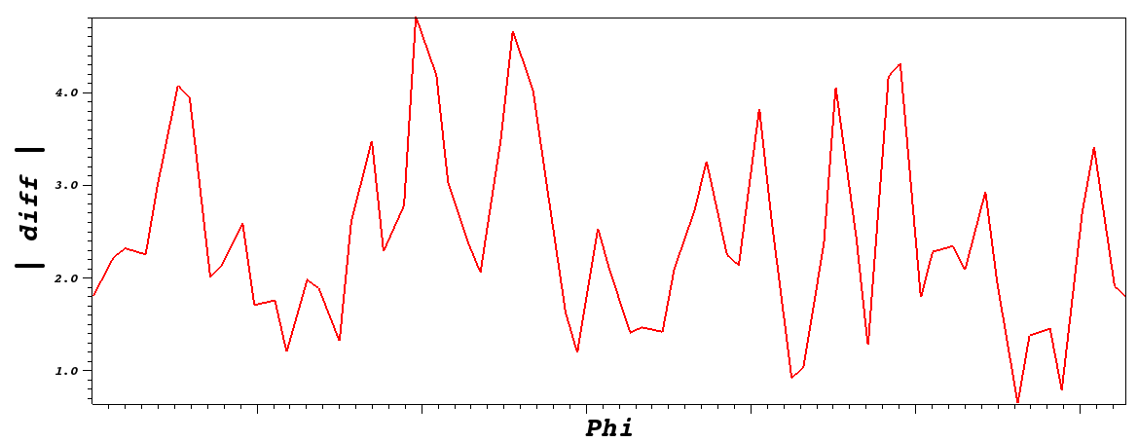
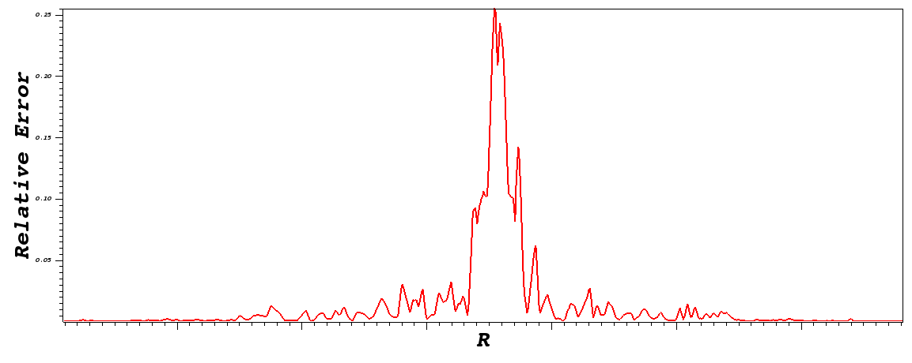
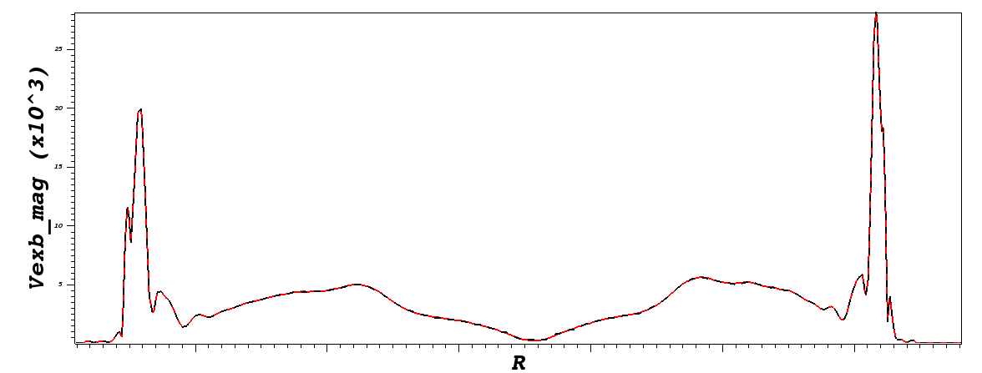
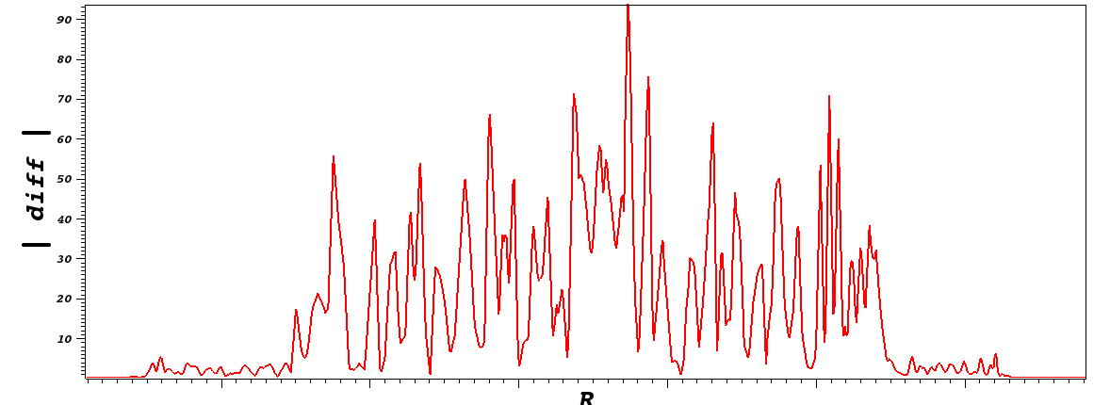
Z=0, | Vexb |
Precision = 3
R=1.2
Phi = pi

Slide 9
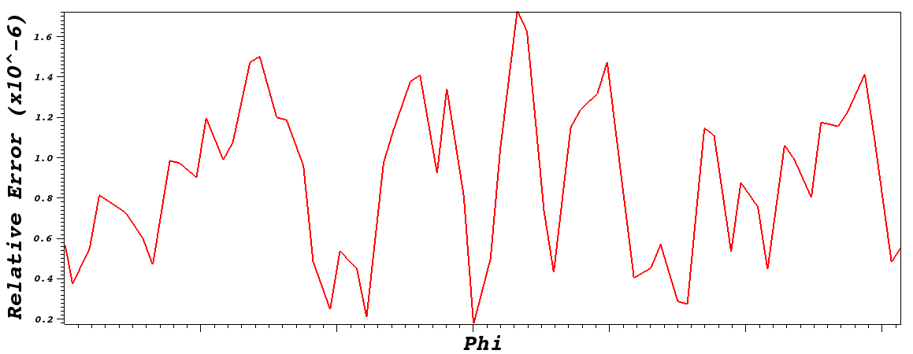
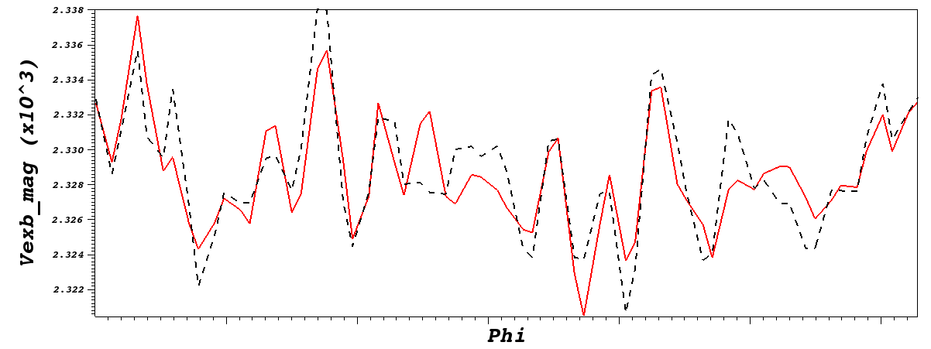
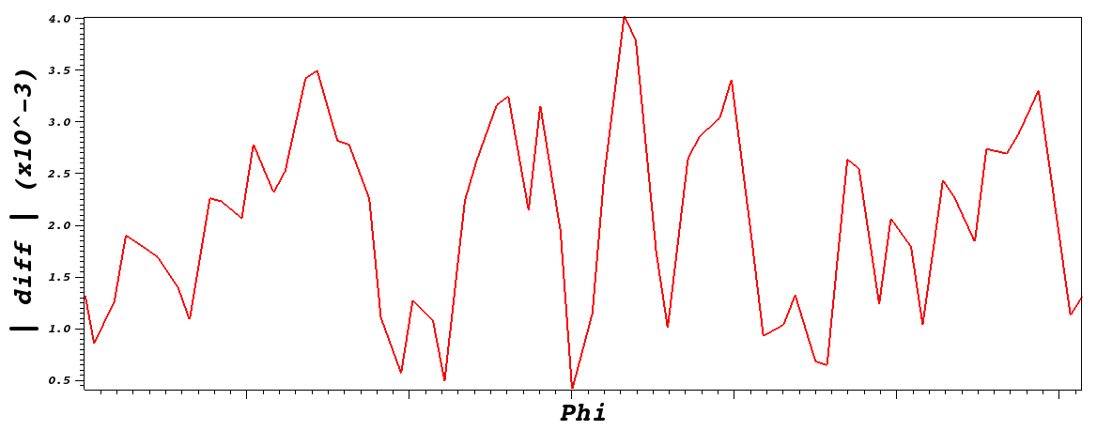
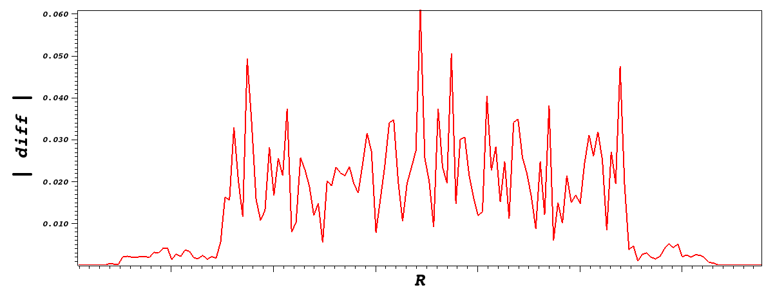
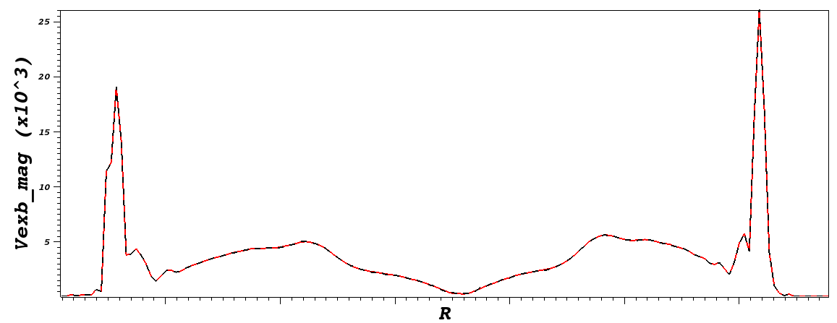
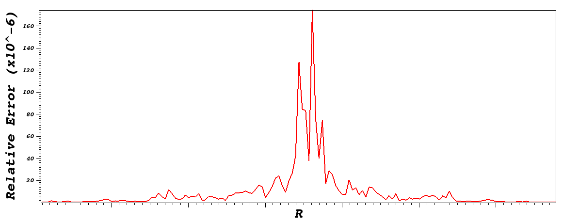
Z=0, | Vexb |
Precision = 6
R=1.2
Phi = pi

Slide 10
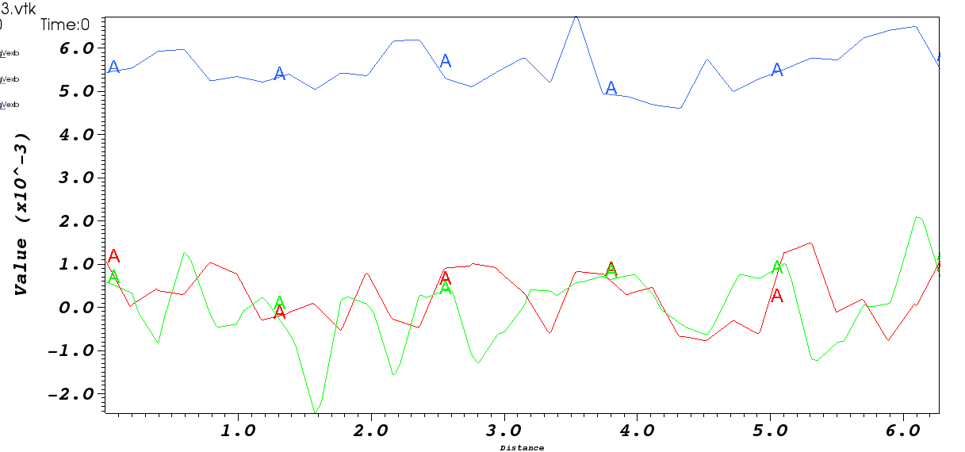
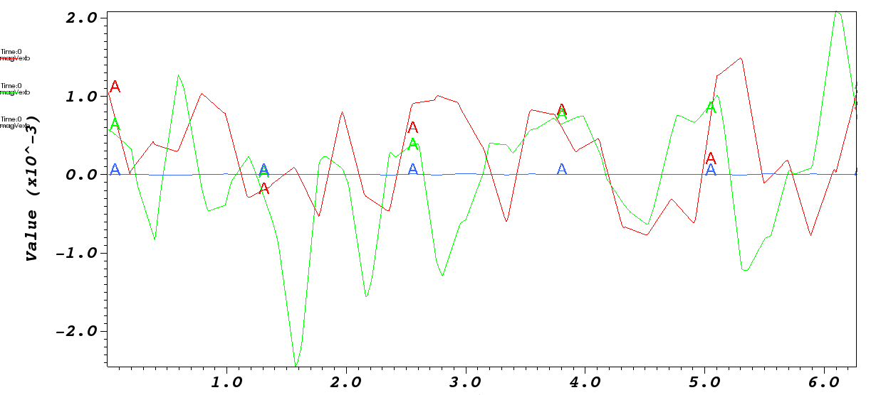
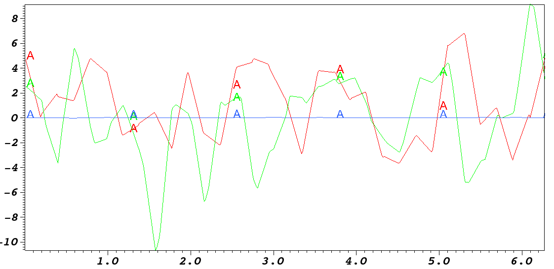
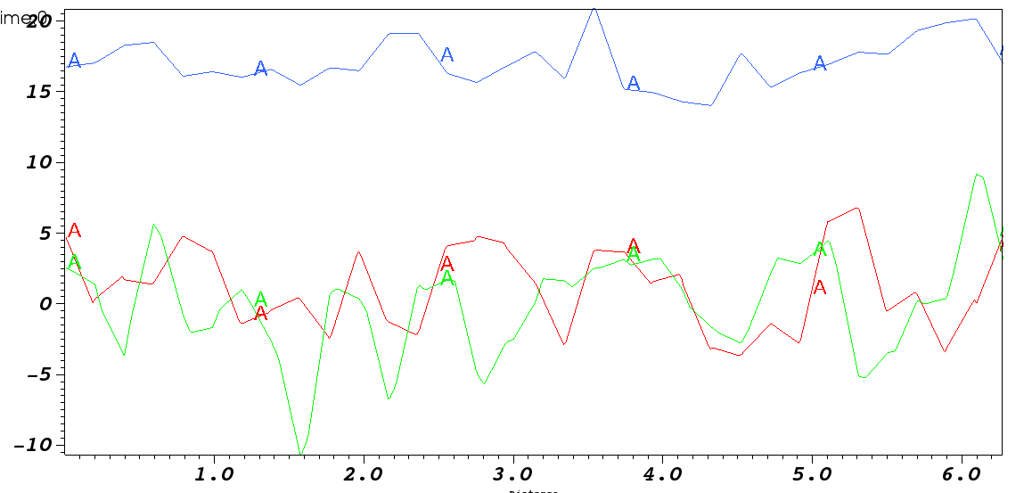
Z=0, | Vexb | R=1.9,2.1,2.2
Precision = 3
Precision = 6
Relative error
Difference

Slide 11
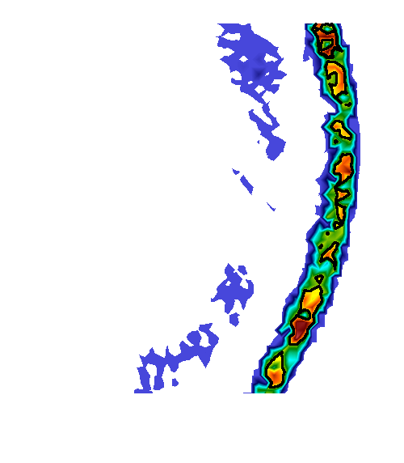
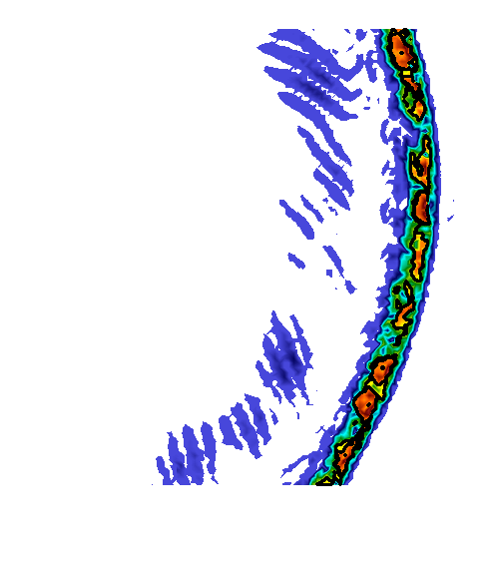
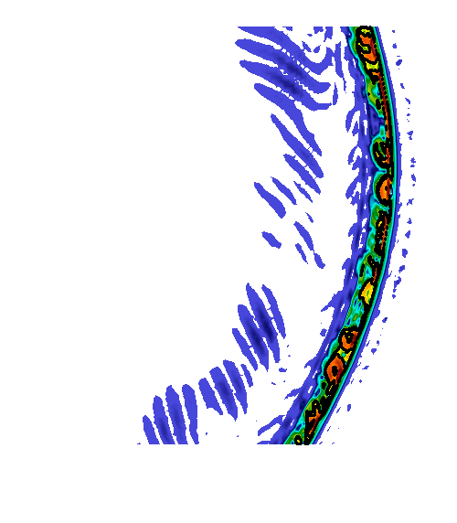


Feature Detection
Precision: full
Decimation: 0%
48 features
Precision: 3
Decimation: 80%
13 features
Precision: 3
Decimation: 58%
17 features
Precision: 6
Decimation: 0%
48 features
Precision: 3
Decimation: 0%
48 features
Precision: 3
Decimation: 10%
56 features

Slide 12
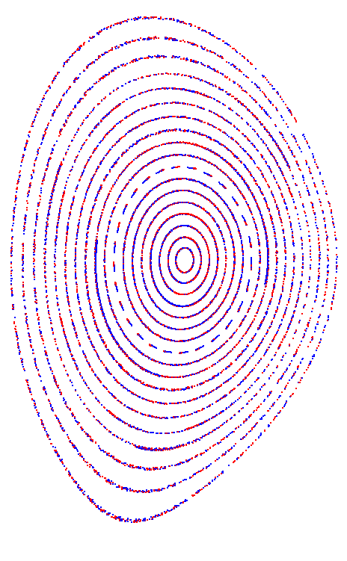
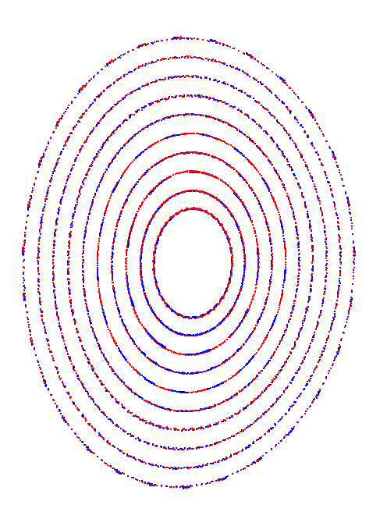
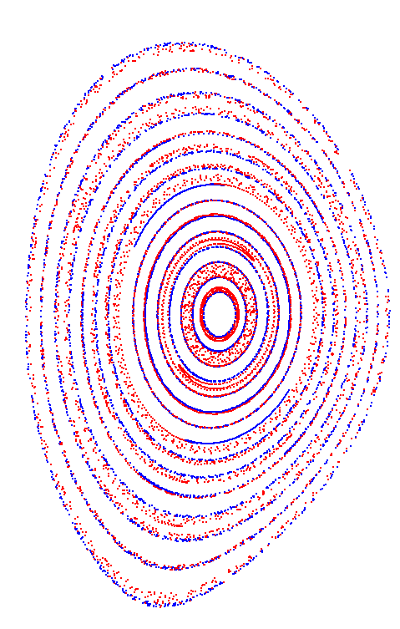
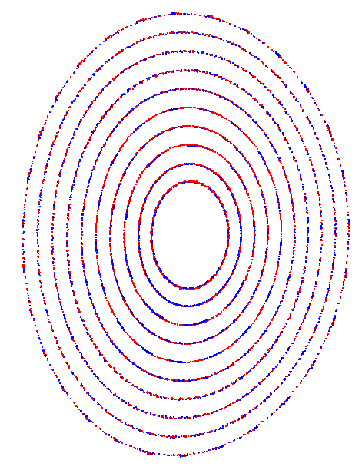
Poincare Analysis
Adams-Bashforth Integrator: step=0.01
Full mesh
Full vs. Decimated
Full precision
Full precision
Fix decimation issues..
Precision=6
Precision FULL: BLUE
Precision 3: RED
Full precision
95% decimation: RED
80% decimation: RED

Slide 13
Poincare Analysis
Adams-Bashforth Integrator: step=0.01
Full mesh
Full vs. Decimated
Full precision
Full precision
Fix decimation issues..
Precision=6
Precision FULL: BLUE
Precision 3: RED
Full precision
95% decimation: RED
80% decimation: RED

Slide 14
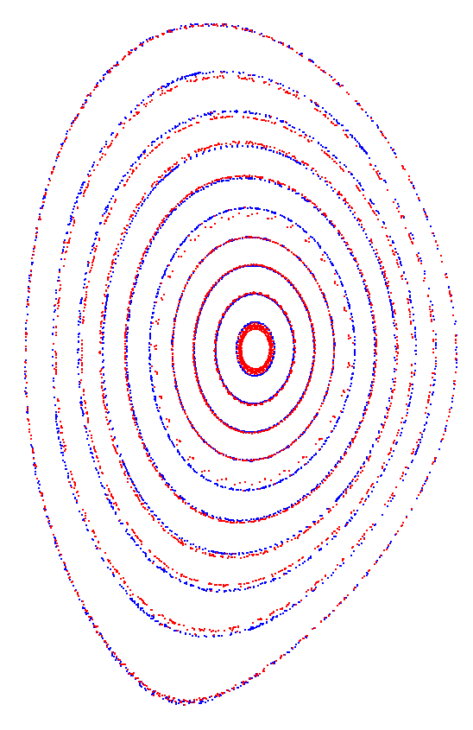
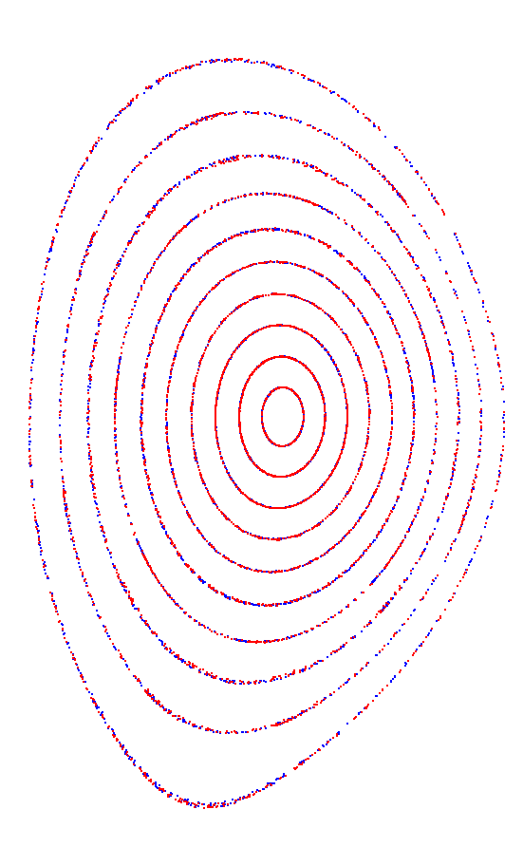
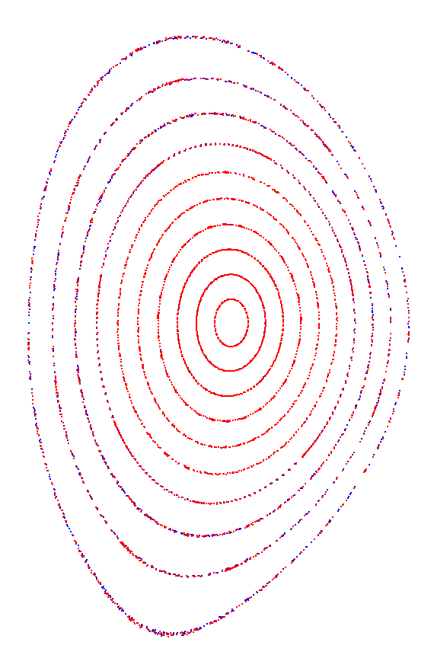
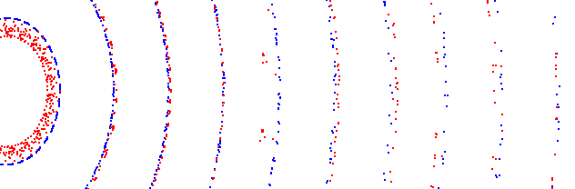
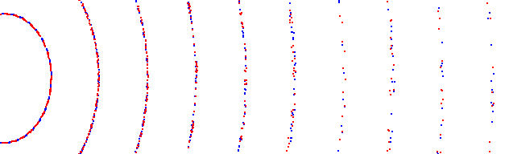
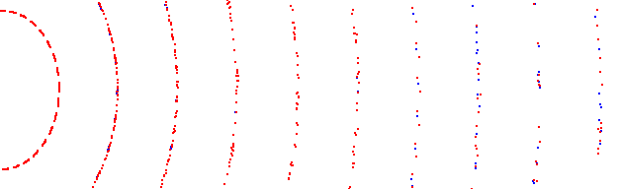
Poincare Analysis
Adams-Bashforth Integrator: step=0.01
Precision ONLY, FULL mesh
Precision FULL: BLUE
Precision 3: RED
Precision FULL: BLUE
Precision 6: RED
Precision FULL: BLUE
Precision 1: RED

